Slide 1
Test Module NodeMCU Code
Network setup, topics, broker connection

Slide 2
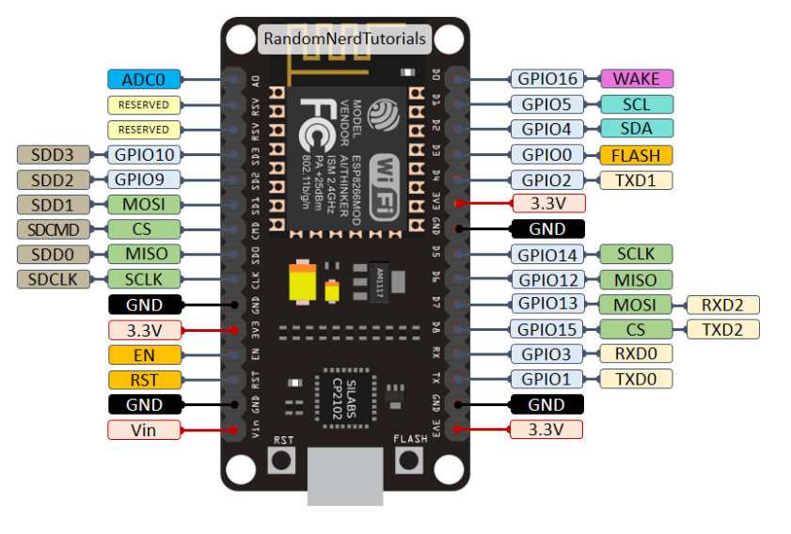
NodeMCU V2.0 Pinout

Slide 3

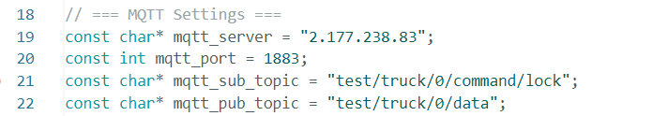
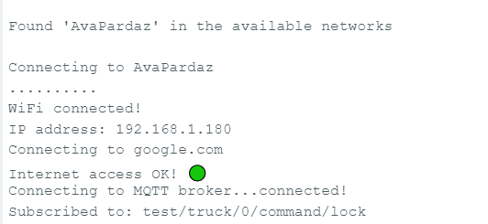
Network Setup
Check the Wi-Fi configs in code. Enter the correct ssid (network name) and password.
Check the MQTT Setting configs in code. Enter the correct broker Public IP address in mqtt_server.
If the above settings are correct, after uploading the code into the board and opening serial monitor (in 155200 baud) you should see success output like below.

Slide 4
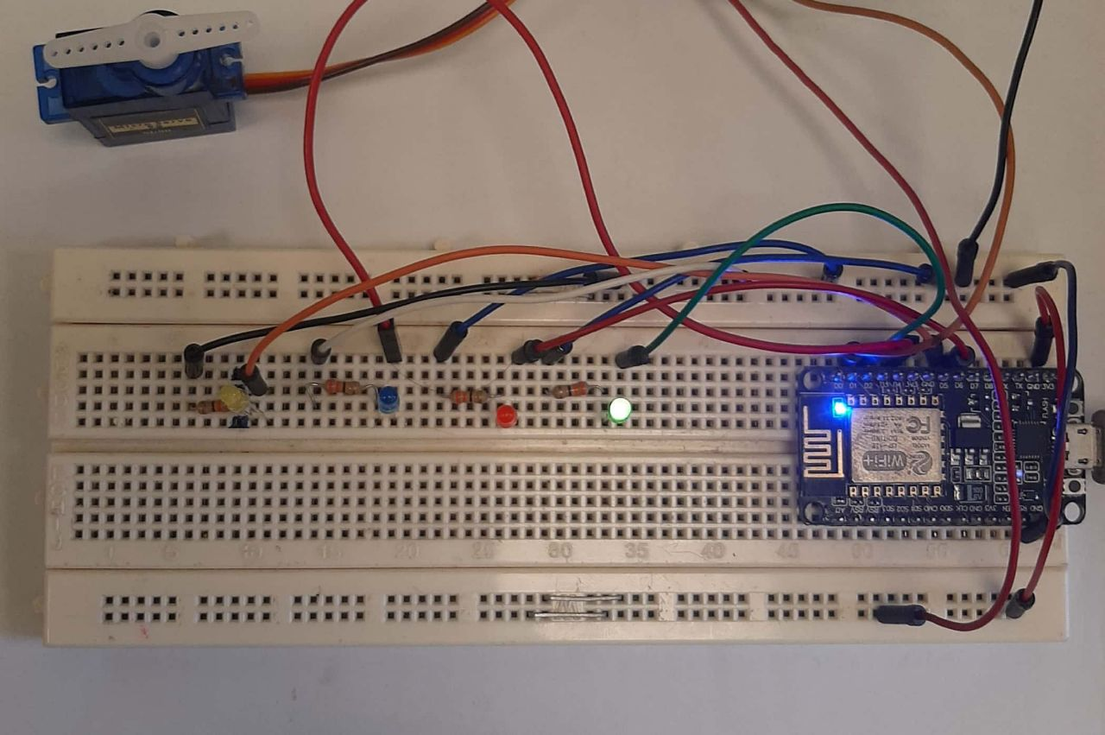
Board
Line #1: Connection status
Green: Wi-Fi is connected
Red: No Wi-Fi
Blue: Module Has sent a payload through MQTT
Yellow: Module Has received a payload from MQTT
Line #2: Lock status
Green: Lock
Red: Unlock
Also, if Servo is connected, it will rotate by
lock, unlock commands
Line #1
Line #2
At the beginning of the process all four LEDs at Line #1 will be On for 1 seconds.

Slide 5
Topics
Broker
Test Module NodeMCU
Publishes on: test/truck/0/data
Can send any payload on any topic
Subscribes to: test/truck/0/command/lock
Expect to receive ‘lock’ and ‘unlock’ text payloads.
Rotates the servo motor accordingly.
mosquitto_sub -h 2.177.238.83 -t test/truck/0/data
mosquitto_pub -h 2.177.238.83 -p 1883 -t "test/truck/0/command/lock" -m "lock"

